Slide 1
Group Work Check the QR code on your table Keep track of your ideas on the Google Doc

Slide 2
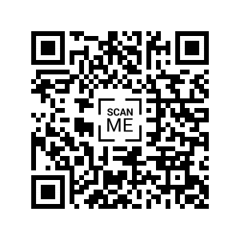
Group 1: http://tinyurl.com/hkuleadership-group1

Slide 3
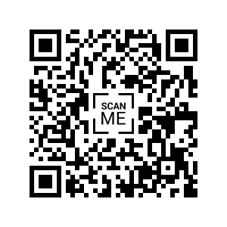
Group 2: http://tinyurl.com/hkuleadership-group2

Slide 4
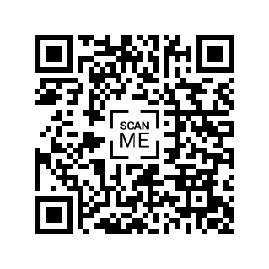
Group 3: http://tinyurl.com/hkuleadership-group3

Slide 5
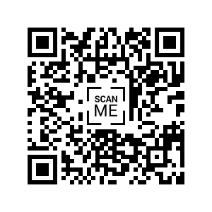
Group 4: http://tinyurl.com/hkuleadership-group4

Slide 6
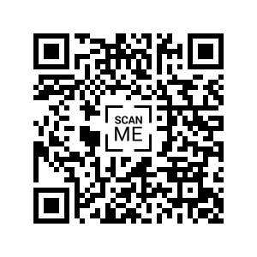
Group 5: http://tinyurl.com/hkuleadership-group5

Slide 7
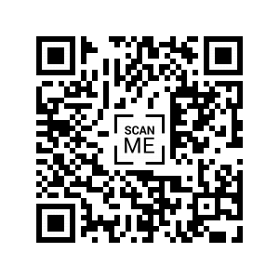
Group 6: http://tinyurl.com/hkuleadership-group6

