Slide 1
Rebuilding Tierra Through Resource Sharing
Presented by: Group 3

Slide 2
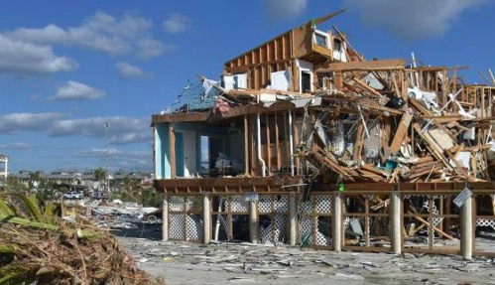
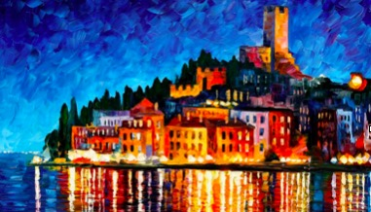
What Have We Lost?
VS
What have we lost forever?

Slide 3
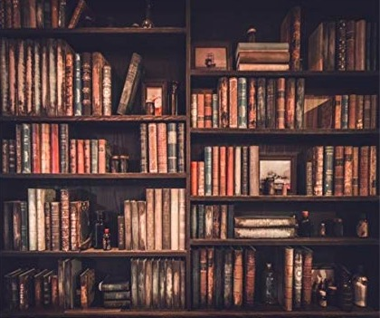
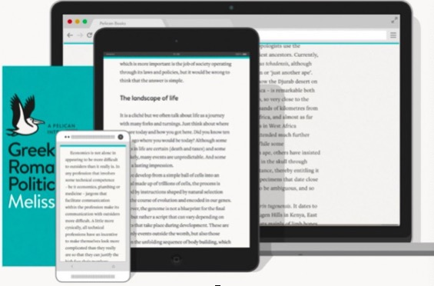
What Will We Need?
VS
Which one is more cost-effective, more convenient to share, and will benefit more Tierrans?
What will we need in the future?

Slide 4
Central e-Cultural Infrastructure in Tierra
Search
Publish
Reuse
Link
Together, we preserve our memories!

Slide 5
Where Are We Now?
1,700,000+ Ancient Books
8,000+ Ancient Pictures
Millions of photos can’t be reproduced
Only with a 18% Digitization Rate (Average Digitization Rate of our neighbor countries is 44.75%)

Slide 6
Purpose
To provide a public space for resource sharing and collaboration among educational and cultural institutions in Tierra to ensure that most useful resources are preserved in a usable form.
Objectives
To collect, digitize and index premier and compelling resources in the community.
To provide advice and training on how to handle with damaged materials.
To preserve records of the disasters and their aftermath.
To help Tierra’s educational and cultural institutions to develop their disaster response plan.

Slide 7
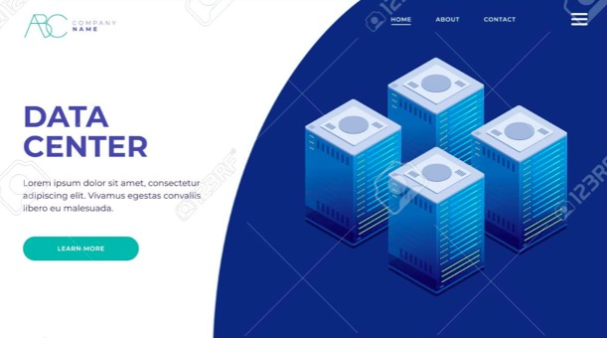
Project Roadmap
2019.9
Inventory
2021.5
User Platform
Share
Safe
Smart
2020.12
Digitization
2019.4
Committee

Slide 8
Time Schedule
Phases | Tasks | Activities | Person In-charge
Phase 1 2019.5-2019.9 | Inventory and organize | Institutions take inventory of existing resources Identify and prioritize materials for digitization, salvage and repair | University of Tierra Library Representative: Hui-Chen Cheng
Phase 2 2019.9-2020.9 | Rescue and repair | Restore resources in stages based on priorities Provide training for students and volunteers for basic preservation treatment | University of Tierra Archives Representative: Andy Yu Historical Archives of Tierra Representative: Yanyan Lv
Phase 3 2019.9-2020.12 | Digitizing | Digitize and catalog the resources Set up the hardware environment and platform | University of Tierra Archives Representative: Andy Yu
Phase 4 2019.12-2021.5 | Display | Build an information management system Build a user-oriented platform | University of Tierra Centre for IT Services Representative: Jenny Wong Higher Technical School of Tierra Library Representative: Lingfang Kong

Slide 9
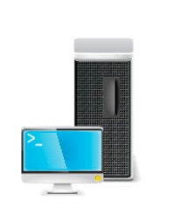
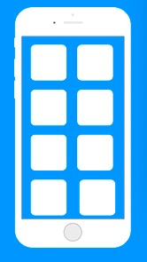
Resources Requirement
$6M
Free
$5M
$3M
$2M
10M
VS
13.5M

Slide 10
Opportunities
In-depth collaboration and cooperation across multiple institutions.
Maximize resources, funds and expertise to help rebuild the community after disaster.
Realize long-term preservation to minimize the loss of resources.
Constraints
Time is a critical factor in salvaging damaged materials.
Insufficient skilled manpower to undertake the additional workload.
Restrictions on storage space.

Slide 11
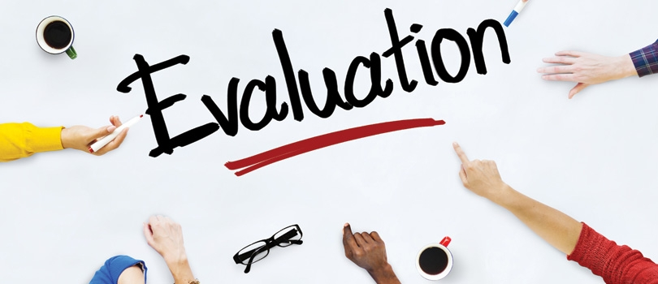
Form a Evaluation Team
Regular meetings and close monitoring the progress
Completion of digitization by phases

Slide 12
Proposed Project Committee Members
Project Lead: Jean Li, National Library of Tierra
University of Tierra Library Representative: Hui-Chen Cheng
University of Tierra Archives Representative: Andy Yu
University of Tierra Centre for IT Services Representative: Jenny Wong
Higher Technical School of Tierra Library Representative: Lingfang Kong
Historical Archives of Tierra Representative: Yanyan Lv

Slide 13
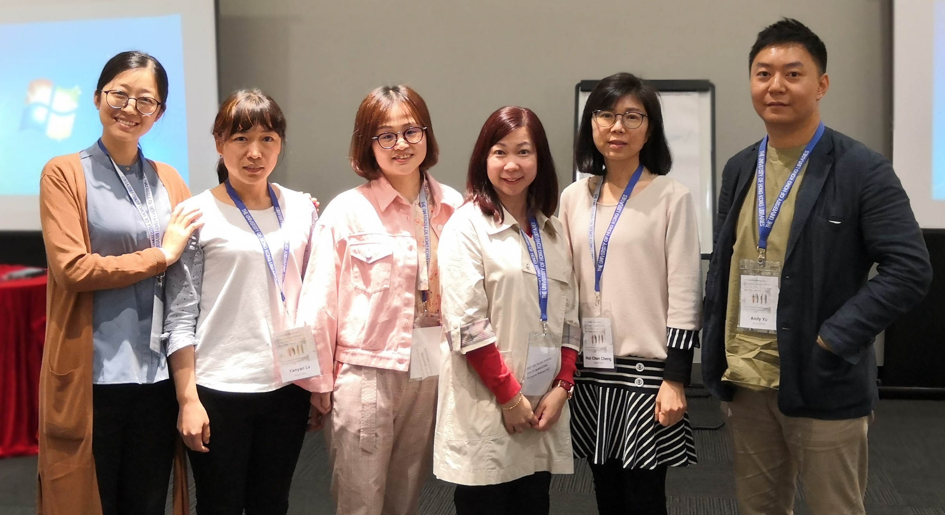

Slide 14
Central e-Cultural Infrastructure in Tierra
Search
Publish
Reuse
Link
Together, we preserve our memories!

Slide 15
Thank You!
Questions?

