Slide 1
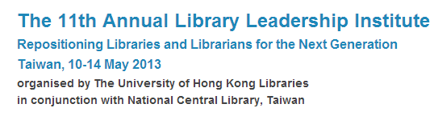
Exploring Current Technology Trends
探索目前的科技趨勢
Marshall Breeding
Independent Consult, Author,
Founder and Publisher, Library Technology Guides
http://www.librarytechnology.org/
http://twitter.com/mbreeding
11 May 2013
HKU Library Leadership Institute

Slide 2
Research Agenda
Develop and distribute data regarding library technology products, services, and organizations
Analysis: surface trends
Help libraries identify appropriate technologies
Guide organizations creating tech for libraries

Slide 3
Research and Reports
Library Technology Guides
LJ Automation Marketplace
ALA TechSource
  Smart Libraries Newsletter
  Library Technology Reports
Many others

Slide 4
Sources and Scope
Gather data from a variety of sources regarding library technologies
Main focus: Library management and discovery applications
Data: libraries and the technologies deployed
Sources: Web, Libraries, Vendors
Library Perceptions

Slide 5
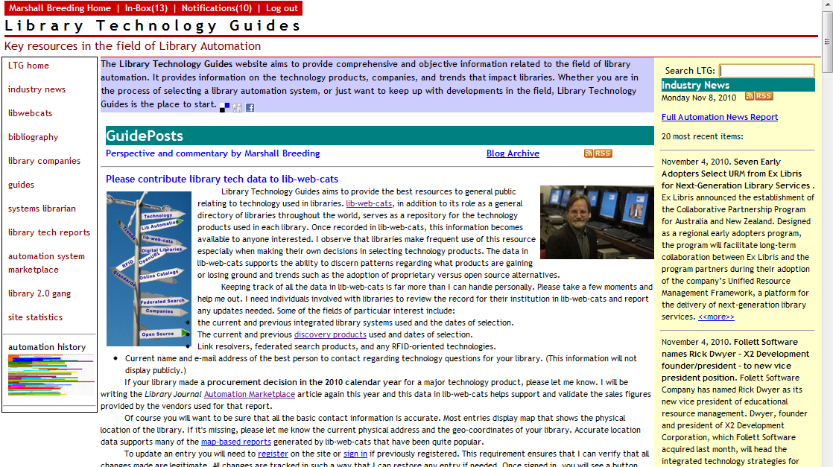
Library Technology Guides
www.librarytechnology.org

Slide 6


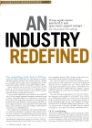


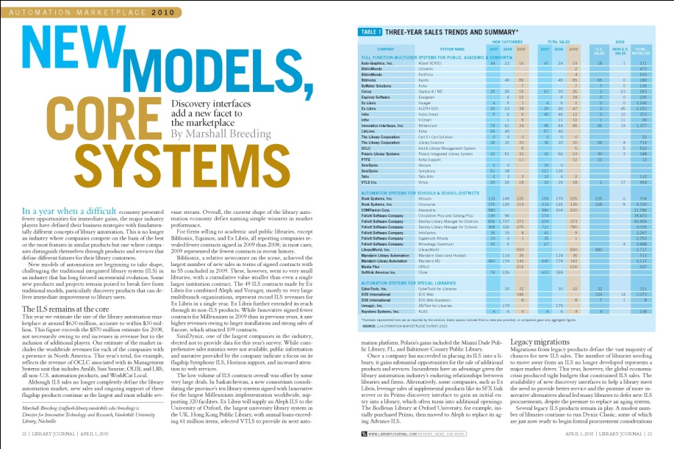
Library Journal Automation Marketplace
Published annually in April 1 issue
Based on data provided by each vendor
Focused primarily on North America
  Context of global library automation
  market

Slide 7
LJ Automation Marketplace
Annual Industry report published in Library Journal:
2013: Rush to Innovate
2012: Agents of Change
2011: New Frontier: battle intensifies to win hearts, minds and tech dollars
2010: New Models, Core Systems
2009: Investing in the Future
2008: Opportunity out of turmoil
2007: An industry redefined
2006: Reshuffling the deck
2005: Gradual evolution
2004: Migration down, innovation up
2003: The competition heats up
2002: Capturing the migrating customer

Slide 8

Library Technology Reports
Resource Sharing in Libraries: Concepts, Products, Technologies, and Trends
January 2013
Vol 49, No. 1

Slide 9
Library Technology Reports
Supplementing your local collection through resource sharing is a smart way to ensure your library has the resources to satisfy the needs of your users. Marshall Breeding’s new Library Technology Report explores technologies and strategies for sharing resources, helping you streamline workflows and improve resource-sharing services by covering key strategies like interlibrary loan, consortial borrowing, document delivery, and shared collections. You’ll also learn about such trends and services as:
OCLC WorldCat Resource Sharing, and other systems that facilitate cooperative, reciprocal lending
System-to-system communications that allow integrated systems to interact with resource-sharing environments
Technical components that reliably automate patron requests, routing to suppliers with tools for tracking, reporting, and staff intervention as needed
Specialized applications that simplify document delivery, such as Ariel, Odyssey, or OCLC’s Article Exchange
How the NISO Circulation Interchange Protocol (NCIP) can enable borrowing among consortial libraries using separate integrated library systems
The Orbis Cascade Alliance consortium, examined using a case study

Slide 10
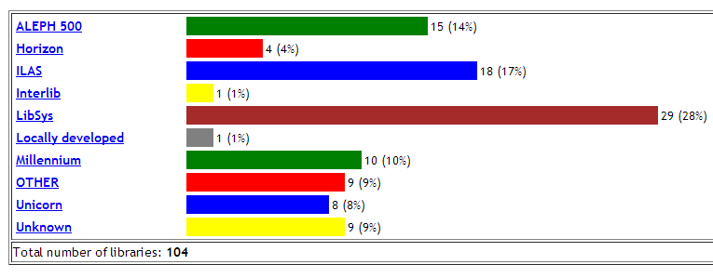
Academic Libraries in China

Slide 11
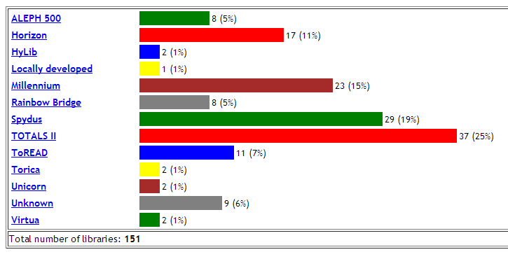
Academic Libraries in Taiwan

Slide 12
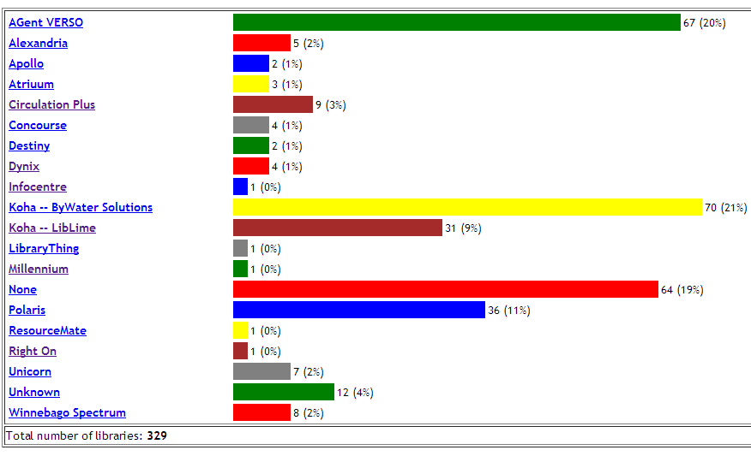
Public Libraries in Kansas

Slide 13
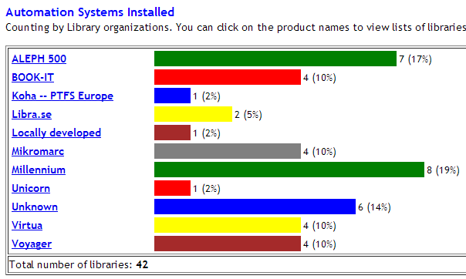
Academic Libraries in Sweden

Slide 14
Public Libraries in Sweden

Slide 15
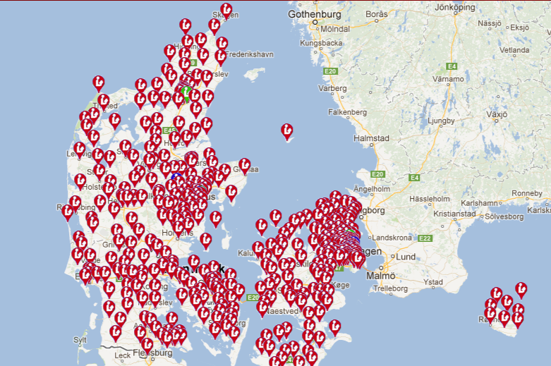
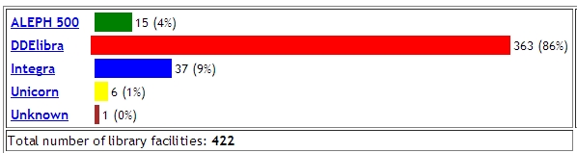
Libraries in Denmark

Slide 16
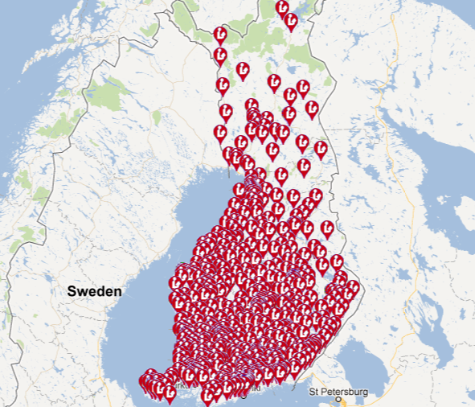
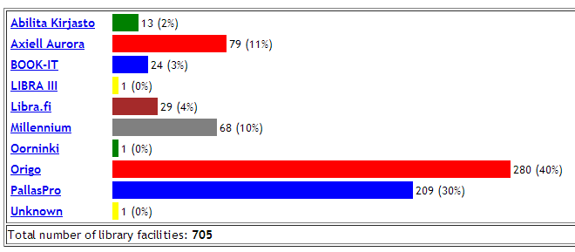
Libraries in Finland

Slide 17
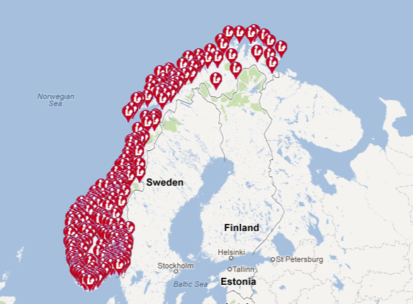
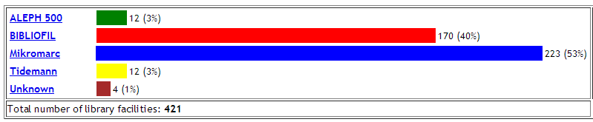
Libraries in Norway

Slide 18
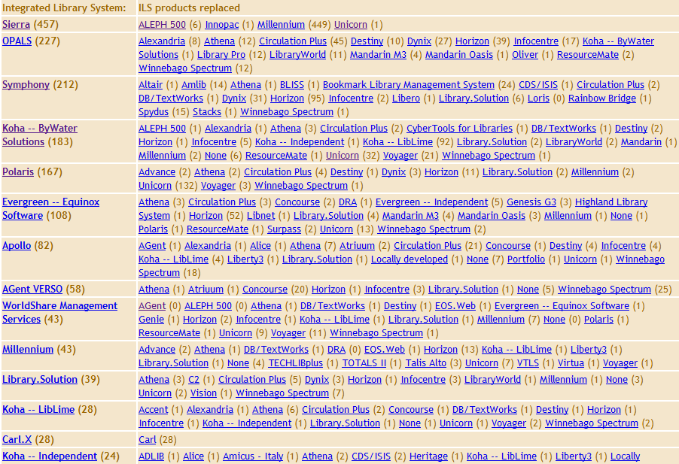
ILS Turnover Report

Slide 19
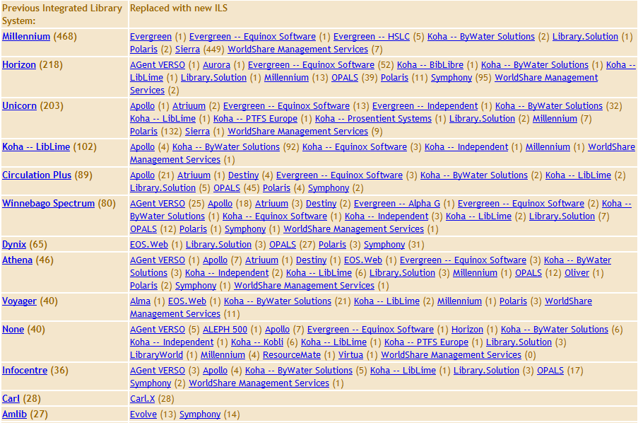
ILS Turnover Report – Reverse

Slide 20
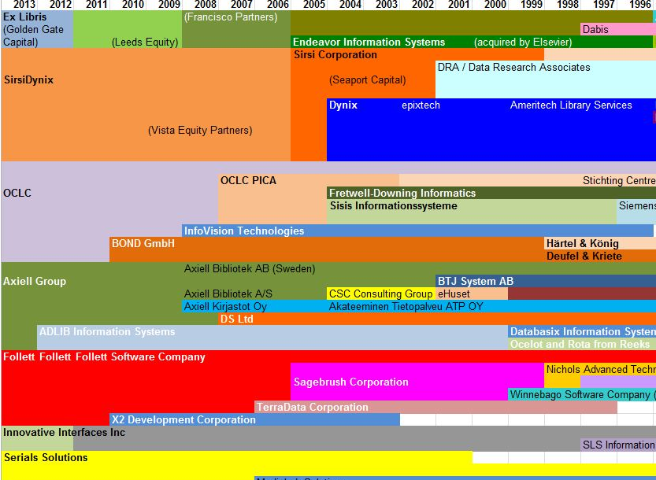
Mergers and Acquisitions

Slide 21
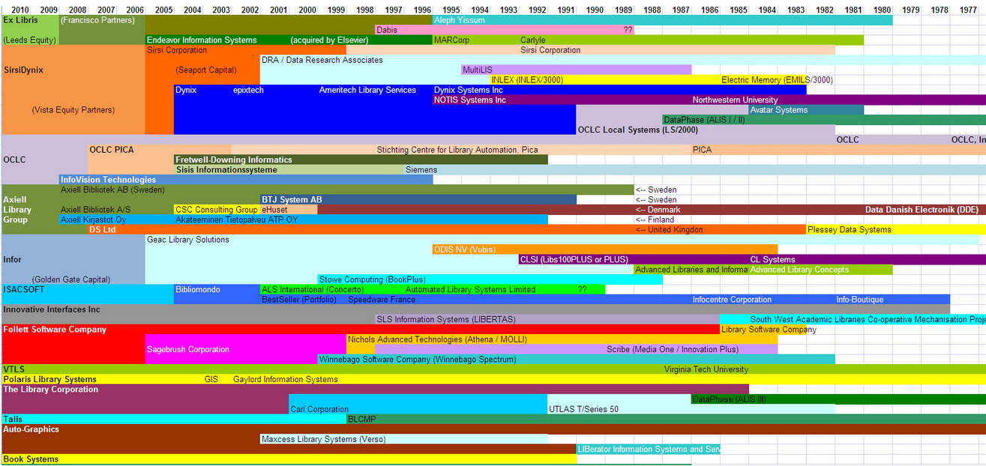
Mergers and Acquisitions
http://www.librarytechnology.org/automationhistory.pl

Slide 22
Key Context: Libraries in Transition
Academic Shift from Print > Electronic
  E-journal transition largely complete
  Circulation of print collections slowing
  E-books now in play (consultation > reading)
Public: Emphasis on Customer Engagement
  Increased pressure on physical facilities
  Increased circulation of print collections
  Dramatic increase in interest in e-books
All libraries:
  Need better tools for access to complex multi-format collections
  Strong emphasis on digitizing local collections
  Demands for enterprise integration and interoperability

Slide 23
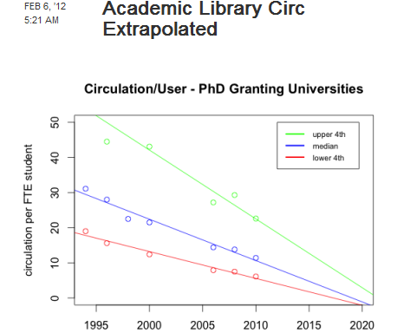
Aaron Schmidt: http://www.walkingpaper.org/5206

Slide 25
Reconceptualization of Automation
Current organization of functionality based on past assumptions
Possible new organizing principles
  Fulfillment = Circulation + ILL + DCB + e-commerce
  Resource management = Cataloging + Acquisitions + Serials + ERM
  Customer Relationship Management = Reference + Circulation + ILL (public services)
  Enterprise Resource Planning = Acquisitions + Collection Development

Slide 26
Overarching concern
Library success depends on technical infrastructure well aligned with its strategic missions
Notes:
A broad view of library automation. Must go beyond the scope of traditional functionality to provide support for all aspects of library operations and service delivery. Support both the activities of staff and patrons in the physical facilities and a powerful and unified Web presence.

Slide 27
Major Technology Trends
Cloud Technologies
Web-based computing
Mobile
Linked Data / Semantic Web
Social Computing

Slide 28
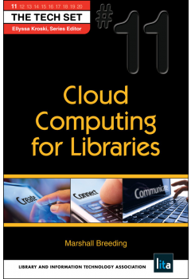
Cloud Computing for Libraries
Book Image
Publication Info:
Volume 11 in The Tech Set
Published by Neal-Schuman / ALA TechSource
ISBN: 781555707859
http://www.neal-schuman.com/ccl

Slide 29
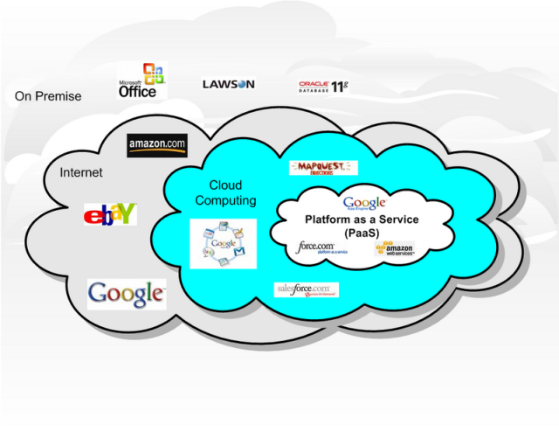
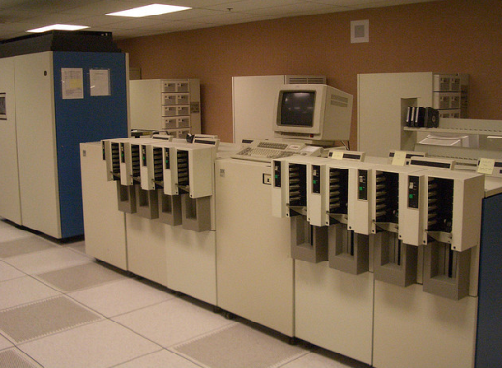
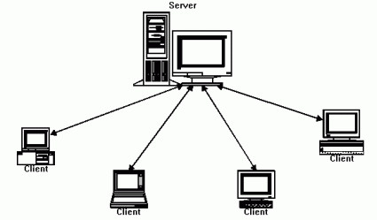
Fundamental technology shift
Mainframe computing
Client/Server
Web-based and Cloud Computing
http://www.flickr.com/photos/carrick/61952845/
http://soacloudcomputing.blogspot.com/2008/10/cloud-computing.html
http://www.javaworld.com/javaworld/jw-10-2001/jw-1019-jxta.html

Slide 30
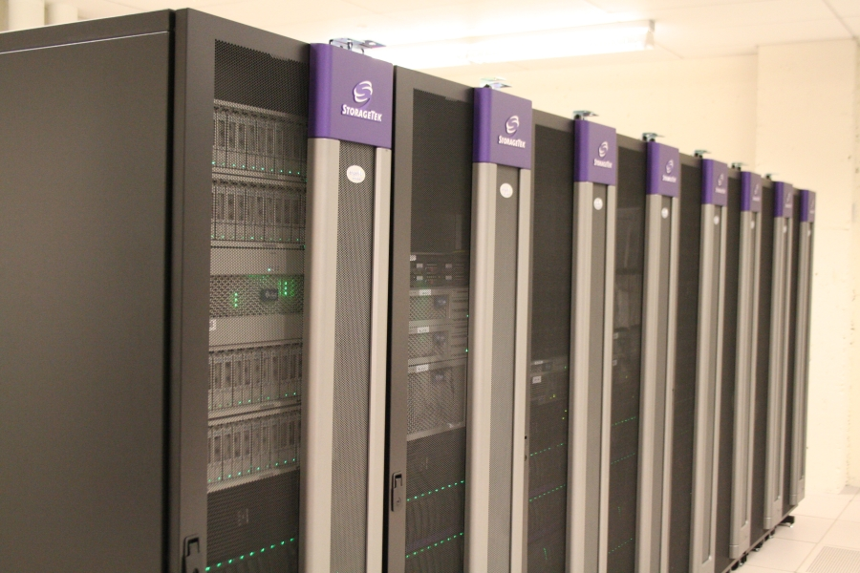
Local Computing
Traditional model
Locally owned and managed
Shifting from departmental to enterprise
Departmental servers co-located in central IT data centers
Increasingly virtualized

Slide 31
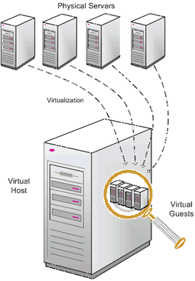
Virtualization
The ability for multiple computing images to simultaneously exist on one physical server
Physical hardware partitioned into multiple instances using virtual machine management tools such as VMware
Applicable to local, remote, and cloud models

Slide 32
Cloud Computing
Major trend in Information Technology
Term “in the cloud” has devolved into marketing hype, but cloud computing in the form of multi-tenant software as a service offers libraries opportunities to break out of individual silos of automation and engage in widely shared cooperative systems
Opportunities for libraries to leverage their combined efforts into large-scale systems with more end-user impact and organizational efficiencies

Slide 33
Beyond “Cloudwashing”
Cloud as marketing hype
Cloud computing used very freely, tagged to almost any virtualized environment
Any arrangement where the library relies on some kind of remote hosting environment for major automation components
Includes almost any vendor-hosted product offering
Example: ASP now Software-as-a-Service

Slide 34
Cloud computing – characteristics
Web-based Interfaces
Externally hosted
Pricing: subscription or utility
Highly abstracted computing model
Provisioned on demand
Scaled according to variable needs
Elastic – consumption of resources can contract and expand according to demand

Slide 35
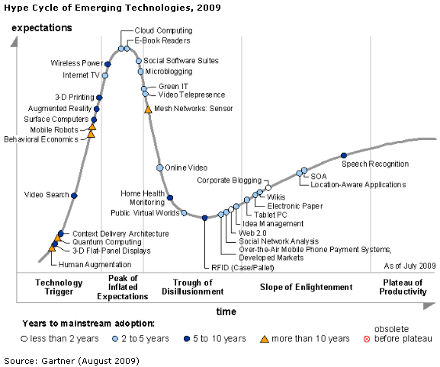
Gartner Hype Cycle 2009

Slide 36
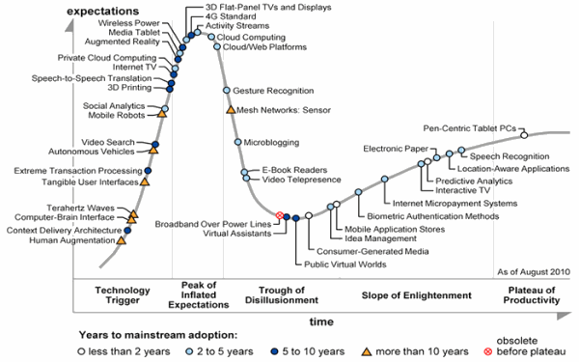
Gartner Hype Cycle 2010

Slide 37
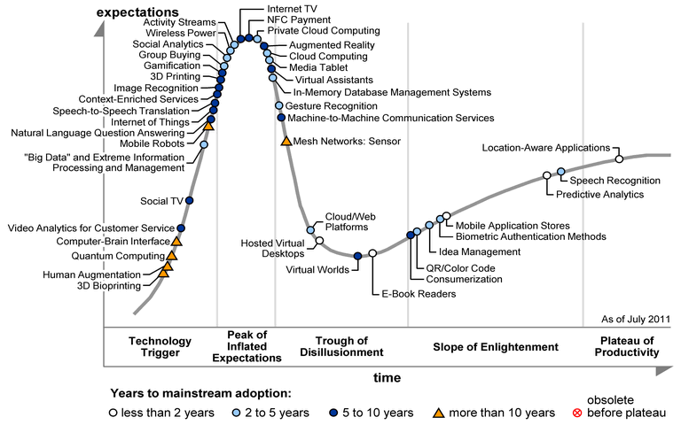
Gartner Hype Cycle 2011

Slide 38
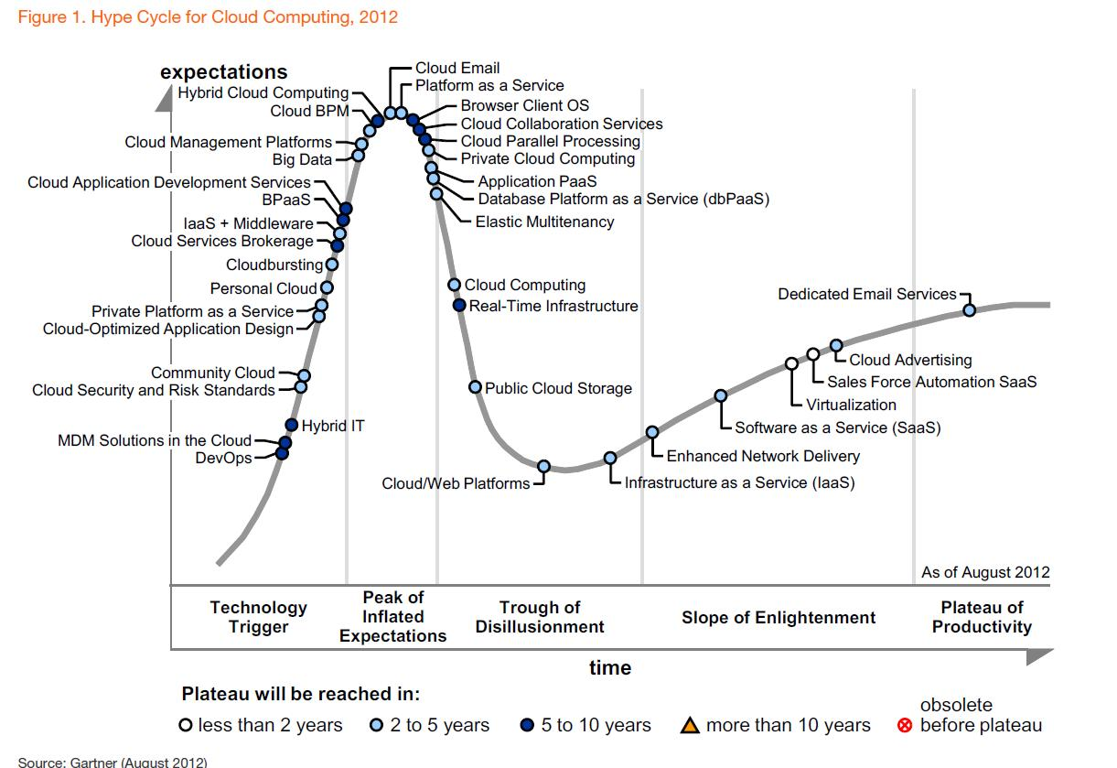
Gartner Hype Cycle 2012

Slide 39
Infrastructure-as-a-service
Provisioning of Equipment
Servers, storage
  Virtual server provisioning
Examples:
  Amazon Elastic Compute Cloud (EC2)
  Amazon Simple Storage Service (S3)
  Rackspace Cloud (http://www.rackspacecloud.com/)
  EMC² Atmos (http://www.atmosonline.com/)

Slide 40
Amazon EC2
Amazon Machine Instances (AMI)
  Red Hat Enterprise Linux
  Debian
  Fedora
  Ubuntu Linux
  Open Solaris
  Windows Server 2003/2008

Slide 41
Software as a Service
Multi Tennant SaaS is the modern approach
  One copy of the code base serves multiple sites
Software functionality delivered entirely through Web interfaces
  No workstation clients
Upgrades and fixes deployed universally
  Usually in small increments

Slide 42
Software-as-a-Service
Complete software application, customized for customer use
Software delivered through cloud infrastructure, data stored on cloud
Eg: Salesforce.com—widely used business infrastructure
Multi-tenant: all organizations that use the service share the same instance (codebase, hardware resources, etc)
  Often partitioned to separate some groups of subscribers

Slide 43
Data as a service
SaaS provides opportunity for highly shared data models
WorldCat: one globally shared copy that serves all libraries
Primo Central: central index of articles maintained by Ex Libris shared by all libraries implementing Primo / Primo Central
KnowledgeWorks database of e-journal holdings shared among all customers of Serials Solutions products
General opportunity to move away from library-by-library metadata management to globally shared workflows

Slide 44
Budget Allocations
Local Computing
Cloud Computing
Server Purchase
Server Maintenance
Application software license
Data Center overhead
  Energy costs
  Facility costs
Annual Subscription
  Measured Service?
  Fixed fees
Factors
  Hosting
  Software Licenses
  Optional modules

Slide 45
Storage-as-a-Service
Provisioned, on-demand storage
Bundled to, or separate from other cloud services

Slide 46
Data as a service
SaaS provides opportunity for highly shared data models
Bibliographic knowledgebase: one globally shared copy that serves all libraries
Discovery indexes: article and object-level index for resource discovery
E-resource knowledge bases: shared authoritative repository of e-journal holdings
General opportunity to move away from library-by-library metadata management to globally shared workflows

Slide 47
Application service provider
Legacy business applications hosted by software vendor
Standalone application on discrete or virtualized hardware
Staff and public clients accessed via the Internet
Same user interfaces and functionality as if installed locally
Established as a deployment model in the 1990’s
Can be implemented through Infrastructure-as-a Service
  Individual instances of legacy system hosted in EC2

Slide 48
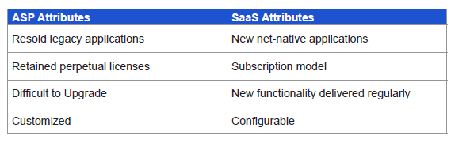
ASP vs SaaS
From: THINKstrategies: CIO’s Guide to Software-as-a-Service

Slide 49
Platform-as-a-Service
Virtualized computing environment for deployment of software
Application engine, no specific server provisioning
Examples:
  Google App Engine
    SDKs for Java, Python
  Heroku: ruby platform
  Amazon Web Service
Library Specific platforms
  WorldShare Platform

Slide 50
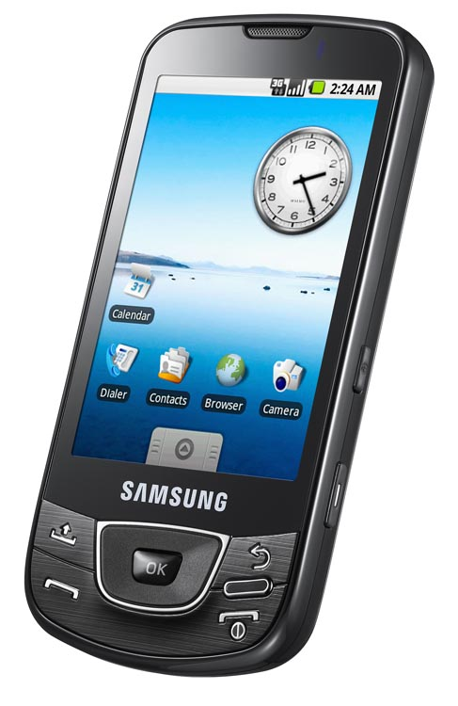
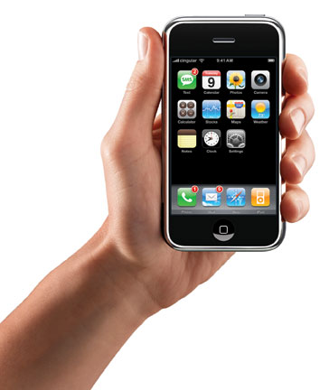

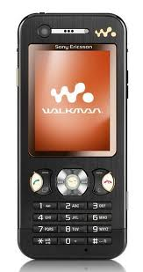
Mobile Computing

Slide 51
Mobile computing
Tipping point of End user access
Mobile exceeds desktop/laptop
Range of devices:
  Tablets: major impact on PC sales
  Smartphones:
Multiple screens

Slide 52
Mobile analytics
Take advantage of Web analytics to measure proportions of use by mobile devices
Google Analytics
  Provides reports of use by operating system, Browser, etc
  iOS, Android, Windows, Mac, etc.

Slide 53
Responsive Web design
Design Web resources to accommodate devices
Uses media queries and other techniques to interrogate device characteristics
Screen size
  Deploy columns and layout according to real estate available
Input capabilities
JavaScript support
Plug-ins available

Slide 54
App vs Mobile Web site
Determine functionality of interest to mobile users
Unified mobile Web presence?
  Proliferation of Web Apps
  Library Specific
  Vended products or services

Slide 55
Mobile access by region
Adoption of mobile varies according to international region
Smartphone demographics in Asia?

Slide 56
Linked Data
Semantic Web concepts present from the beginning of the Web
Relatively little implementation until recent years
HTML delivers Web pages designed for humans
  Content + CSS for presentation elements
RDF delivers documents designed for computers

Slide 57
Linked data techniques
RDF Triplestore
  Subject – Predicate – Object statements
  “Herman Melville” -> “author” -> “Moby Dick”
Microdata
  Google Rich Snippets
Schema.org
  Supported by Google, Bing, Yahoo, etc

Slide 58
Open Linked Data
Data that can be publicly shared
  Ideally Creative Commons Public Domain License (CC0)
Expressed as Linked Data
  Usually RDF Tripplestores
Increasingly expected in digital library projects
  Europeana

Slide 59
Bibliographic transport
MARC designed as transport for bibliographic records during mainframe era
MARC not human readable
MARC not machine readable
Interest in working toward new standard for transport of bibliographic data using linked data technologies
Library of Congress initiative for Bibliographic Transformation
See: Bibframe.org

Slide 60
Other bibliographic standards
Resource Description and Access (RDA):
  Replaces AACR2 as standard for cataloging rules and syntax
Functional Requirements for Bibliographic Records
  Work > Expression > Item [verify]

Slide 61
Social computing
All major Web destinations fully embrace social interactions
Facebook, Twitter, LinkedIn dominant in United States
E-Commerce driven by social interactions
  Discovery, Reviews, recommendations

Slide 62
Social identity
Social containers for identity management
Platform for exchange of social data

Slide 63
Social Computing in Libraries
Facebook Pages
Facebook Apps
Socially oriented discovery and portals
  BiblioCommons, ChiliFresh
Connect library content with social platforms
  GoodReads, LibraryThing
  Citation Engines
  Mendeley (Recently acquired by Elsevier)
  Zotero

Slide 64
Service-oriented Architectures
Creation of computer applications using very small units of functionality (Services)
Multiple services composed into larger functional components
Automation of workflows
Business Process Modeling

Slide 65
Application Programming Interfaces
APIs exposed to facilitate
  Extensibility
  Interoperability
Provides a platform for programmers and integrators

Slide 66
Open Source / Open Access
Openness highly valued by libraries
Open Access:
  Content available freely
Open Source:
  Software with freedom to use, modify, distribute without cost

Slide 67
Enterprise Interoperability
Expectation that business applications within an organization be able to interoperate and exchange data
Shared authentication
Consume and provide enterprise services
Implemented through API integration

Slide 68
Shared Infrastructure
Increasing interest in simplifying computing infrastructure among related organizations
Less reliance on individual implementations
Shared participation in business applications
Reliance on cloud-based applications

Slide 69
Tagging and inventory Technologies
Barcode > RFID
QR Codes
NFC: Near Field Communications

Slide 70



Open Source Integrated Library Systems
Major thread in library systems development
  Koha
  Evergreen
  Kuali OLE

Slide 71
Open Source Automation Systems
Koha
  smaller public and academic libraries
  Used for some consortia (SKLS)
Evergreen
  Designed for Library Consortia
Kuali OLE
  Designed for large research libraries

Slide 72
Koha
Traditional ILS developed in Open Source model
Perl / MySQL / Linux
Problems with scaleability
  Apache SOLR, Plack added recently
New US contracts going mostly to smaller public and academics

Slide 73
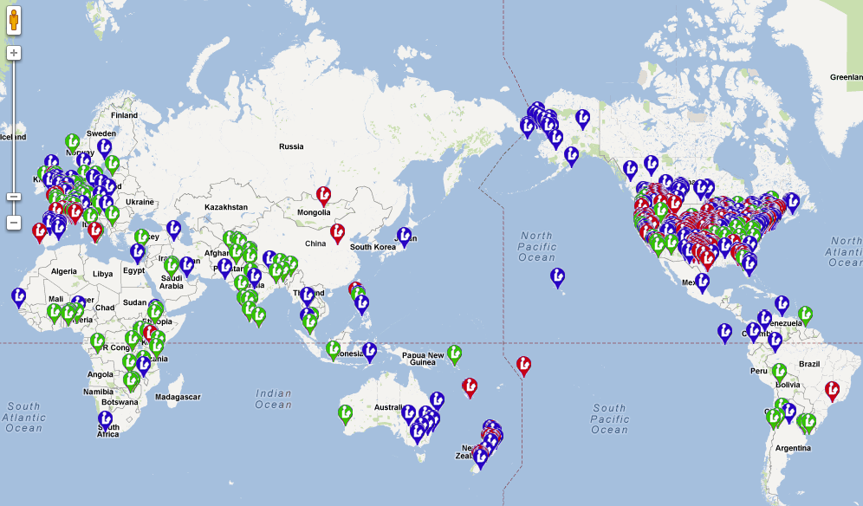
Koha Libraries Worldwide

Slide 74
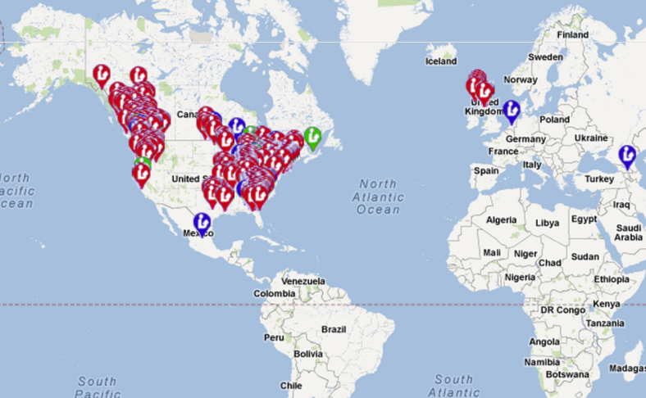
Evergreen Libraries Worldwide

Slide 75
Evergreen
Popular system for state funded initiatives
  Georgia Pines
  Virginia Evergreen
  Indiana Evergreen
  Pennsylvania Integrated Library System: SPARKS
  Massachusetts: CW/MARS, Bibliomation, Merimack
  British Columbia SITKA
  North Carolina Cardinal
  Vermont: new Catamount project

Slide 76
Kuali OLE
Enterprise level library services platform
Financial and in-kind contributions from investing institutions
Matched by the Andrew W. Mellon Foundation
Major academic libraries in the US involved as original investing partners
UK: Senate House Library + Bloomsbury Colleges now committed in principal

Slide 77
Kuali OLE Timetable
In development since 2009
Some libraries may go live in 2013
GOKb project started in 2012 for e-resource management

Slide 78
Open Source ILS environment
Partially funded through grant funding
  IMLS
  Andrew W. Mellon Foundation
  State grants

Slide 79
Open Systems
Achieving openness has risen as the key driver behind library technology strategies
Libraries need to do more with their data
Ability to improve customer experience and operational efficiencies
Demand for Interoperability
Open source – full access to internal program of the application
Open API’s – expose programmatic interfaces to data and functionality

Slide 80
Development Resources
Company | Dev | Sup | Sales | Admin | Other | Total
Ex Libris | 170 | 231 | 54 | 44 | 13 | 512
Follett Software Company | 87 | 143 | 86 | 49 | 0 | 365
Innovative Interfaces, Inc. | 83 | 158 | 43 | 24 | 3 | 311
SirsiDynix Corporation | 84 | 166 | 51 | 23 | 56 | 380
Serials Solutions | 80 | 50 | 46 | 4 | 57 | 237
Axiell | 57 | 66 | 34 | 35 | 34 | 226
The Library Corporation | 39 | 91 | 28 | 13 | 28 | 199
Polaris Library Systems | 27 | 42 | 15 | 2 |  | 86
VTLS Inc. | 24 | 48 | 12 | 8 | 18 | 110
Koha
ByWater Solutions | 3 | 12 | 3 | 3 | 1 | 13
Catalyst IT | 3
BibLibre | 4 | 3
Koha Total (estimated) | 15
PTFS | 5 | 16 | 8 | 8 |  | 155
Evergreen
Equinox Software | 6 | 5 | 2 | 3 | 5 | 21

Slide 81
The rise of e-books
Academic libraries: e-books included in aggregated content packages
  E-books used primarily for research and consultation, not long reading
Public Libraries: Subscriptions to e-book services that provide an outsourced collection of loanable e-books
K-12 Schools, Colleges, Universities: interest in electronic textbooks

Slide 82
E-Book Challenges for Libraries
Work toward legal framework that preserves the role and value of libraries to provide access to materials without cost
Work toward business model where libraries can acquire materials at reasonable costs
Deliver materials with through a user-friendly experience
  It should be easier to borrow an e-book from a library than purchase one from an online store

Slide 83
Integrating e-Books into Library Automation Infrastructure
Current approach involves mostly outsourced arrangements
Collections licensed wholesale from single provider
Hand-off to DRM and delivery systems of providers
Loading of MARC records into local catalog with linking mechanisms
No ability to see availability status of e-books from the library’s online catalog or discovery interface
Notes:
Will you be speaking to the current work being done with OverDrive, 3M and other eBooks providers and the major ILS systems to integrate the check out and download of eBooks directly from the library’s catalog/discovery platform?

Slide 84
Legal / Business issues
E-book products generally involve licenses that provide access to titles but may not constitute full ownership of materials.
Will libraries need to re-purchase titles if they switch e-book providers
Lending models mostly adhere to restrictions consistent with print:
  Only one reader can access each copy licensed
  Digital copies may need to be repurchased after designated number of uses (Example HarperCollins)
No “doctrine of first sale:” Rights of the library limited by the publishers

Slide 85
Challenges for library automation
Provide the same types of management control for e-books as other collection component
  Acquisitions: select and acquire materials from multiple providers
  Cataloging: High-quality descriptive metadata
    Electronic copies appropriately aligned with those in print or other media
  Circulation: Integrated with other media.
    Option to lend e-reader devices
  Discovery
    Integrated with all other formats
    Unified environment for content delivery

Slide 86
Recent partnerships
Polaris
  3M Cloud library
SirsiDynix
  Baker & Taylor Axis 360
  Recorded Books
  Overdrive
  3M Cloud Library
The Library Corporation
  Overdrive
  eBiblioFile MARC records for e-book collections

Slide 87
Technology Issues
Access to materials controlled through Digital Rights Management
Closed ecosystems that control content through identity management and rights policies
Imposes significant overhead on the user experience:
  Download an install DRM components
  Establish user credentials in site trusted by DRM
  Works only with devices that comply with DRM restrictions

