Slide 1
Atlantis University Library
3-year staffing proposal
Prepared by Group 5

Slide 2
Background
1960s - close door-policy
premier academic library, 400 years history
population 14,000 students, 3,000 faculty
rich collection of Atlantisian materials
Feb 29, 2013
new King, the country open up

Slide 3
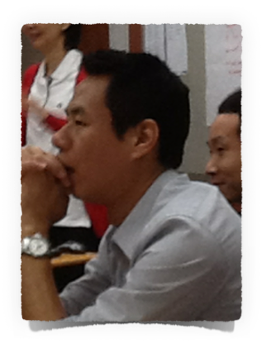
Oliver Oneoneo's Assumptions
Some staff have knowledge on technology
10% increase in library staffing is equivalent to 6 additional staff (new management staff)
Budget is not a problem (with largest gas reserves)

Slide 4
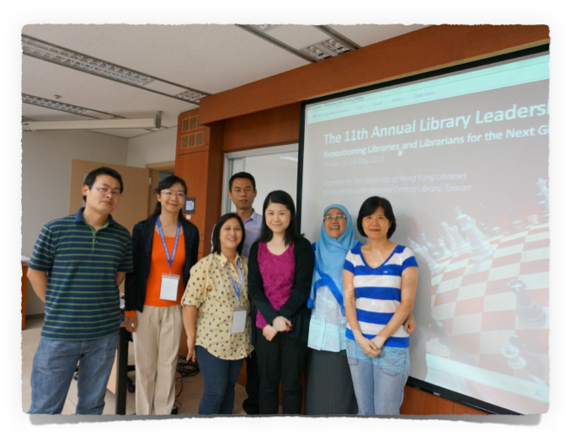
Oliver Oneoneo, AUL Deputy Librarian and AUL Senior Management Team -- experts, tested, and reliable

Slide 5
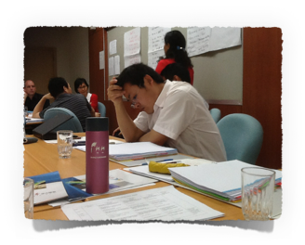
The next generation library is part of every STUDENTS LEARNING EXPERIENCE
Thus, the library should:
provide space for social interaction as well quiet study area
provide high-tech facilities to support the users needs (resources, gadgets, digitization, communication facilities)
accessible in the Internet, cloud technology, social media
be able to market itself (exhibitions and research projects)

Slide 6
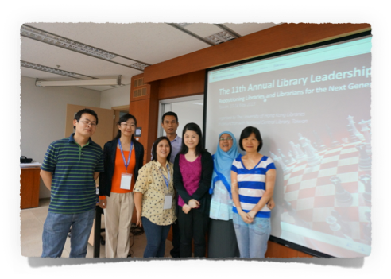
Rationale
To have the BEST LIBRARY STAFF who will transform AUL to a premiere academic library of the next generation

Slide 7
STRATEGY
Next-generation AUL
User needs analysis
GAP?
Strategic planning
Strength/Weaknesses
Opportunities/Threats
Assessment of current staff
AUL at present

Slide 8
Analysis
Strengths:
great Atlantisian materials,
materials are well catalog
Weaknesses:
derelict building,
books are shabby,
limited e-resources,
low technology

Slide 9
AUL at present
Strength: Staff assessment
64 library staff:
16 professionals and 48 staff
36 degree holder and 12 non-degree
Average 10 years working in the library
Very good staff performance
Hardworking, self motivated, loyal, committed
Weaknesses:
Not familiar with English
Needs to upgrade their library skills

Slide 10
Analysis
Opportunities
Collaboration with the 4 universities
Networking with other countries
Donations from other libraries
Threats
Changes that will be implemented (staff rotation, new organizational structure)
New technology

Slide 11
AUL at present
Opportunities: Staff assessment
Average 10 years working in the library
Loyal, committed to the library
(Nobody request to be transferred)
Threats:
How to adopt to CHANGE

Slide 12
Recommendations: 1st year
Hire new management team - new ideas
Review the human resource management system
Set-up Staff development program (Phase 1)
Send supervisors to the 12th HKUL LEADERSHIP INSTITUTE
Basic library and IT skills training for all
Customer relationship training (personality development, self-confidence, language training)

Slide 13
Major HR Activities for the 1st year:
Develop a 3 year Strategic Plan with ALL the staff
Improvement of IT infrastructure -- prepare staff for the technology
Redesign the library layout-- staff should be responsive to this change

Slide 14
2nd year
1st year performance evaluation/promotion
specialized training - digitization, cataloging, collection management
Mores focused marketing projects (training/retraining)
Development of volunteer programs -- translation of collection, develop research on the use of collection
Exchange programs within/outside university

Slide 15
3rd year
2nd year performance evaluation/promotion
1 year action planning of the staff to make necessary adjustments
More specialized training on preservation, technology trends
Additional staff to handle increasing no. of users
Another 3-5 year strategic plan

Slide 16
It is the best proposal because it has...
A Clear vision
Well defined strategies
Annual evaluation was set to make adjustments
BEST MANAGEMENT TEAM

Slide 17
Finale!
We have overcome
We have overcome
We have overcome the task today...

