Slide 1
Preserving our Past: Creating our Future A Proposal
Group #4

Slide 2
Outline
Vision
Goals
Measurement
Assessment

Slide 3
1. Vision
YouAndMe University Library will be recognized as most innovative, user-centred academic library in this area.

Slide 4
1. Major objectives
Digitization
Promotion of the Rare book collection
Increase budget on electronic resources ; buy lesser print
Organizational change (staffing)

Slide 5
2. Goals
To Attract users to use the library
Environment
-Setup attractive workspace for users
Resources
-Build user-oriented collection and focus on unique resources
Services
-Provide innovative services
Staff
-Build efficient, highly trained staff
Collaboration

Slide 6
2.1 Environment
Physical:
Learning Commons
Multi-media center
More network points, electricity sockets etc.
Virtual:
Redesign library Website Using Information Architecture Principals
More web services

Slide 7
2.2 Resources
Increase the percentage of electronic collections
Repair and digitize rare books collection ; promote this unique collection.
Setup Institutional Repository

Slide 8
2.3 Services
Communications
Subject librarian: Serve the faculty to meet their teaching and research needs
Setup the user focus group and meet regularly
Foster Information literacy
Online guides
Online instructional multimedia
Promote library’s services
Social networking (Blog/Twitter/whatsapps/Facebook)
Electronic Newsletter
Smartphone apps
Use tablet/mobile devices.
Promote rare-book on tablet (e.g. iPad/Galaxy Tab)

Slide 9
2.4 Staffing
Library Reorganization
Redeployment
Training
Develop a strong IT team to support new innovative services
Staff development

Slide 10
2.5 Collaboration
Participate actively in CLUNC
share the manpower (union catalog)
share resources with other libraries(ILL, Document delivery)

Slide 11
3. Measurement
By Library Gate count
By number of web visitors
By Alexa web ranking

Slide 12
4. Evaluation / Assessment
Statistics
Analyze the system log and make a comparison.
Survey
Users satisfaction level

Slide 13
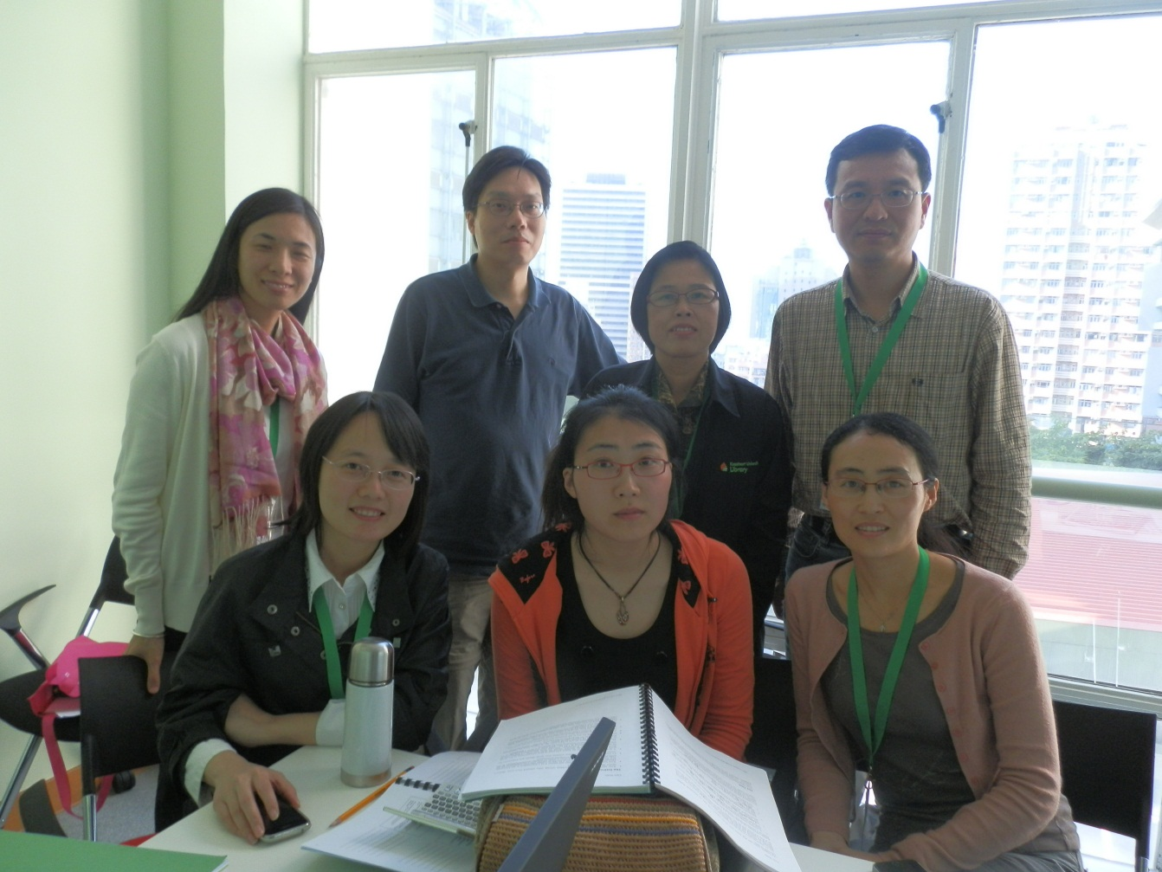
Thank you!

