Slide 1
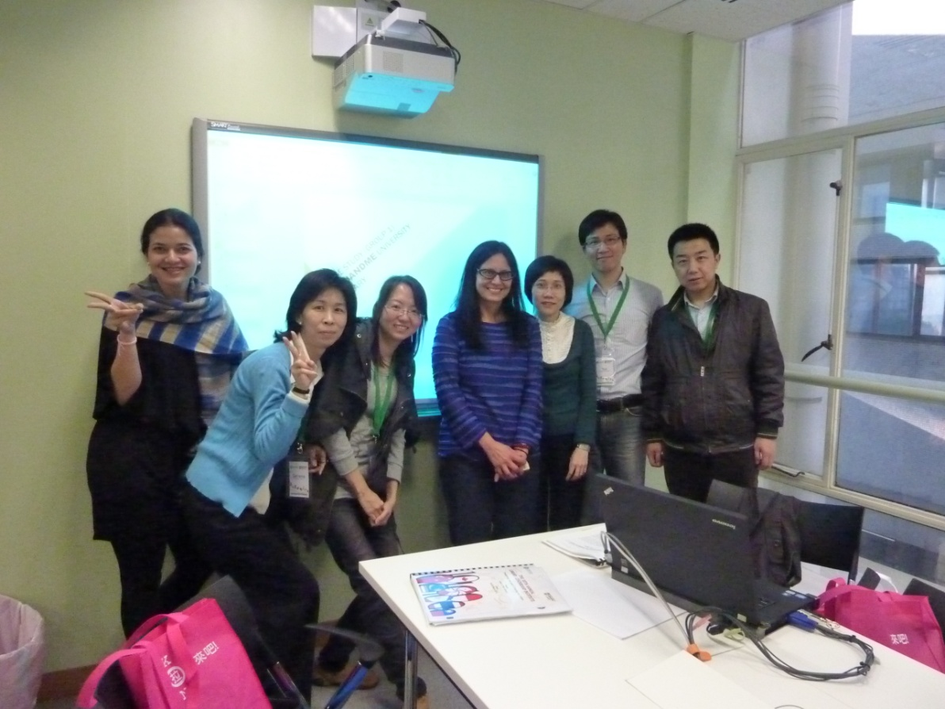
Case Study (Group 1) YouAndMe University Library

Slide 2
PROCESS
Day 1 – identified problems, drafted vision and set objectives
Day 2 – defined the objectives with some more detailed solutions, designed action plans and assessment for whole strategic plan
Everyone contributed to brainstorming and discussion. Documented through note taking. Not one facilitator, shared. We tried to come up with actions for specific objectives, but found difficulty in trying to treat some of them as separate objectives with separate actions.
Many of them overlap. Not hierarchical.

Slide 3
Problems
Funding setbacks
Staff redundancies
Few electronic resources
Peer libraries – similar services, CLUNC already established, but little collaboration and benefit
Little collaboration across campus (IT, teachers, librarians, specialists rare come together for planning or strategic thinking)
Not enough emphasis on teaching and learning
Student dissatisfaction
Rare collection in very poor condition due to long time neglect and
Tropical climate
Assets:
CLUNC alliance in place, but underused
Rare book collection
Researchers
President of university internationally recognized historian and rare book expert
All 5 university administrators want collaboration and streamlining amongst all

Slide 4
Vision
The library aims to support the University mission of becoming an institution that is respected equally for teaching/learning as well as research.

Slide 5
staffing
Create task force to implement restructuring
Reduce staff redundancies through retirements
Retrain staff if necessary
Redeploy staff
Create new position descriptions and teams to handle restructuring (IT, electronic resources librarian; marketing PR, fund raising and CRM; special collections/preservation)
Embedded librarians (interaction with researchers, teachers, help with course development and support, work with students on information literacy)
Student ambassadors
not necessarily in this order

Slide 6
Objectives
Bring teaching and learning to the forefront while maintaining and further enriching focus on research
Improve student satisfaction - make library more visible/desirable
Demonstrate efficiencies and savings through collaboration
within library
within university
within alliance of 5 universities
Distinguish the YouAndMe University Library from the other four libraries in the region by promoting the rare book collection

Slide 7
Actions Objective 1 Bring teaching and learning to forefront while maintaining & further enriching focus on research
Develop electronic resources and provide easy access 24/7
Improve the function of the consortium to get better price for purchases and subscriptions increasing resources for users
Perform collection analysis
Provide faculty with teaching and research support
Encourage professional library staff to pursue research interests – offer sabbaticals or build in research time to work schedule

Slide 8
Actions Objective 2 Student satisfaction improvement- make library more visible/desirable
Survey students (baseline evaluation and after)
More resources available with easy accessibility
Redesign learning areas within library including quiet study area, group discussion rooms, classrooms, creative media equipment, game room
Offer student training on new resources
Promotional events for library – lucky draw, book talks, musical performance, electronic books database game, online quiz with prizes, make use of social networking services, book sales
Roaming librarian/student helper to help users

Slide 9
Actions Objective 3 demonstrate efficiencies and savings thru collaboration: within library, within university, within alliance of 5 universities
Inside the library:
Focus group, Task force, Quality control circle, cross-units staff development
Library & University:
Embedded librarian, Consultation research,
Library and other libraries:
exchange program with other library for duplicates---not necessarily CLUNC
ILL and document delivery, chat with reference, bundle e-purchasing power, build a shared high-density storage facility (collections not jointly shared, but cost of building and running the facility shared. moving print collections off-site opens room in library for creating new types of spaces and makes it easier to maintain proper environment for storing collections – often different temp/RH requirement than comfort level for people)

Slide 10
Action objective 4 Distinguish the YouAndMe University Library by promoting the rare book collection
Invite the President to do a show-and-tell session of rare books.
Researchers work with student ambassadors from relevant department(s) to select books for exhibition, and publication? Digitization?
Develop course based on strengths of the collection.
Hire a consultant to look at collections and do assessment (to apply for funding for preservation)
Cooperate with history (?) or other department to share cost?

Slide 11
Assess – Reflect - look ahead
5 year plan
Eg. Electronic resources increase funding by 10% each year (reduction in purchase of print books, paperbacks, reset priority for subscriptions, if e-resources available, do not purchase print)
Surveys for students and faculty
User focus group
Online suggestions/comments
Benchmarking with other libraries
Internal key performance indicators (KPI)
Establish systematic approach for tracking progress from the outset, documentation!

